Slide 1
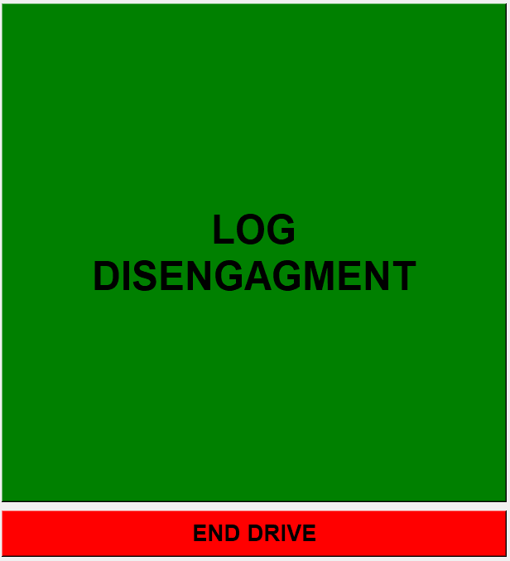
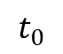
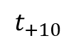
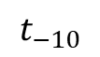
Disengagement GUI 2.0 - Week 2
Safety driver interacts with GUI via the touchscreen front monitor.
GUI auto launches with Mercury PC.
The first window only displays 2 clickable buttons:
“LOG DISENGAGMENT” records and saves 10 seconds of video before and after event
$$t_{0}$$
$$t_{−10}$$
$$t_{+10}$$
Information is saved in local .CSV file
“LOG DISENGAGMENT” also pulls GPS Latitude and Longitude from rostopic echo /GPSDiag
(next page)

Slide 2
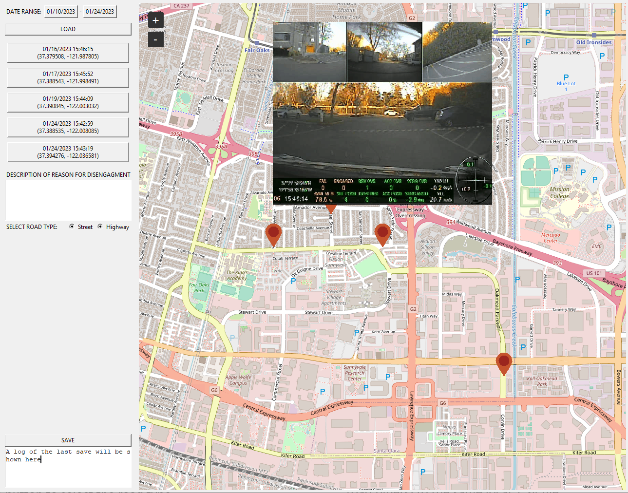
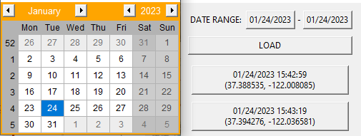
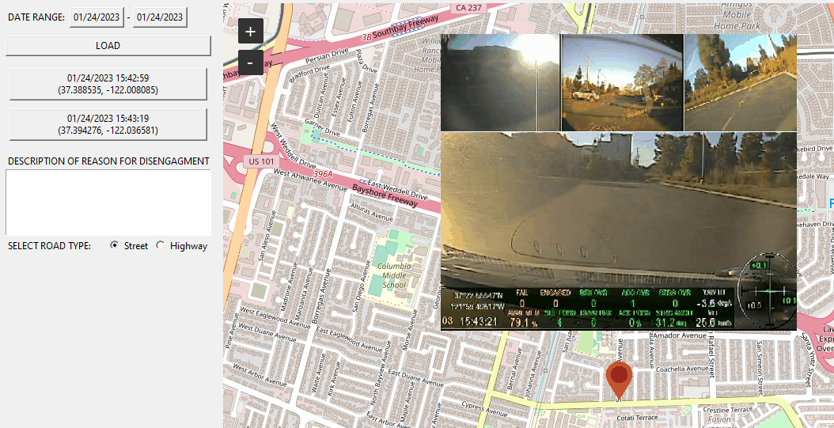
Disengagement GUI 2.0 - Week 2
main reporting window
“END DRIVE” brings the GUI to the main reporting window:
Auto loads today’s date or a date range is also selectable to review previous disengagements.
Clicking a disengagement zooms in and displays the recorded video clip, a text field to enter a description and a button to select the road type.
The “SAVE” button logs the newly entered description(s) and road type(s) to the same local .CSV file.

